Slide 1
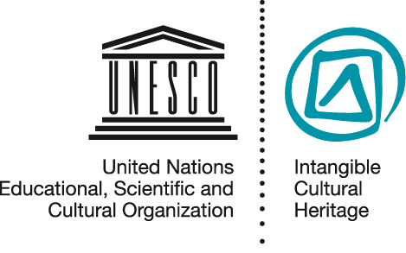
Key concepts
NOM PPT 5.3
UNESCO
Intangible Cultural Heritage Section

Slide 2
In this presentation...
Words to think about
Domesticating the Convention
Intangible Heritage
Communities
Safeguarding

Slide 3
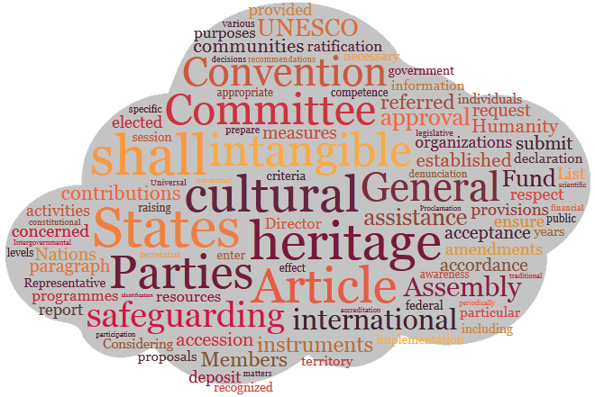
Word cloud of the Convention

Slide 4
Words to think about
Intangible heritage
Safeguarding
Threats and risks
Inventorying, Revitalization, Awareness-raising
Community
Community, group, individual
Practitioner, tradition-bearer

Slide 5
Domesticating the Convention
The term “ICH” translated
Turathi za tamaduni zisizogusika (Kiswahili)
Di sản văn hóa phi vật thể (Vietnamese)
Vaimne kultuuripärand (Estonian)
Património cultural imaterial (Portuguese)

Slide 6
Intangible heritage

Slide 7
Intangible Heritage
Article 2:
For the purposes of the Convention ‘ICH’ means
the practices, representations, expressions, knowledge, skills
– as well as the instruments, objects, artifacts and cultural spaces associated therewith –
that communities, groups and , in some cases, individuals) recognize as part of their cultural heritage

Slide 8
Intangible Heritage
The definition continues:
This ICH, transmitted from generation to generation,
is constantly recreated by communities and groups in response to their environment, their interaction with nature and history,
and provides them with a sense of identity and continuity,
thus promoting respect for cultural diversity and human creativity.

Slide 9
Intangible Heritage
The definition continues further:
For the purposes of this Convention, consideration will only be given to such ICH as is compatible with existing international human rights instruments,
as well as with the requirements of mutual respect among communities, groups and individuals,
and of sustainable development.

Slide 10
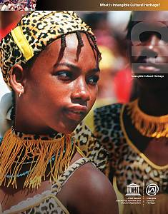
Some Intangible Heritage Domains mentioned in article 2.2 of the Convention
(a) oral traditions and expressions, including language as a vehicle of the ICH; (b) performing arts; (c) social practices, rituals and festive events; (d) knowledge and practices concerning nature and the universe; (e) traditional craftsmanship.

Slide 11
Zema liturgical music
A form of liturgical music distinctive to orthodox Christian Ethiopia, Zema is performed at various religious ceremonies such as the monthly celebration of Gabra Manfas Qedus, a local saint. While the singers wear simple white cloths, the priests pictured here, gathered in front of the Saris ’Abo church in Addis Ababa, wear sumptuous costumes and carry covered icons on their heads.

Slide 12
The Hudhud Chants of the Ifugao
Well known for their rice terraces and extensive knowledge of rice cultivation, the Ifugao perform the Hudhud chants during the sowing and harvest seasons and at funeral wakes. The chants are transmitted orally and are about ancestral heroes, customary law, traditional practices and religious beliefs.

Slide 13
Vanuatu Sand Drawings
Sand drawing is a multifunctional “writing” produced on the ground, in sand, volcanic ash or clay, using one finger to draw a graceful, often symmetrical composition of geometric patterns.
It serves as a means of communication among the members of some 80 ethno-linguistic groups in Vanuatu.

Slide 14
Communities

Slide 15
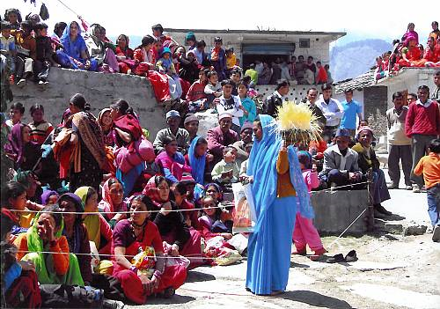
Defining the community concerned
Under the Convention, ‘communities, groups and individuals concerned’ means those who participate in the practice or transmission of the ICH element, and consider it to be part of their cultural heritage
Ramman: religious festival and ritual theatre of the Garhwal Himalayas, India © IGNCA, Ministry of Culture

Slide 16
The relationship
Creation, practice and transmission; ownership
Communities, groups or individuals concerned
ICH element
Sense of identity & continuity, enjoyment, pride, sometimes also income generation

Slide 17
Safeguarding

Slide 18
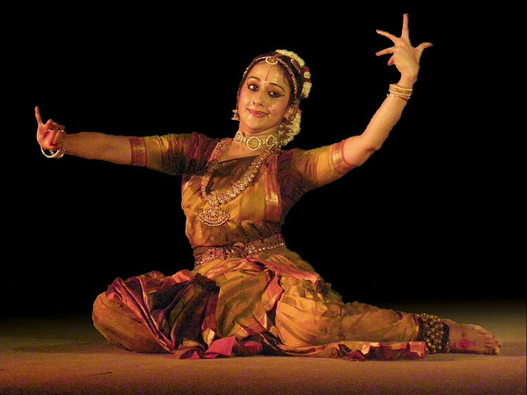
Safeguarding concepts
Safeguarding is ensuring the viability of ICH
Threats to viability are current problems hampering the enactment and transmission of the element.
Risks are anticipated problems.
Notes:
http://www.flickr.com/photos/34056112@N00/2289578246/
Uma Muralikrishna performing Kuchipudi at Yamini 2008 at IIM Bangalore. By Vasanthakumar

Slide 19
Key safeguarding measures
Inventorying
Awareness-raising
Encouraging people to understand and appreciate the ICH
Collecting and presenting information on ICH elements in a systematic way
Revitalization
Strengthening of seriously endangered ICH practices

Slide 20
More safeguarding measures
Documentation, research
Identification, definition
Preservation, protection
Promotion, enhancement
Transmission, e.g. through education
Ensuring access to places and materials

Slide 21
The role of communities
Identification
Inventorying
Documentation
Research
Revitalization
Ensuring sustainability
Ensuring access to places and materials
Transmission through education
Transmission
Enactment
Communities
Groups
Awareness-raising
Other agencies

Slide 22
Points to remember
Intangible heritage is living heritage
Always changing
Practiced by people
Safeguarding involves assisting communities to continue practicing and transmitting their ICH

